Slide 1


Precious Metals & Rhenium Consortium
SVHC Roadmap Work Group
20 April 2016
10:00-12:00 CET

Slide 2

Welcome and Introduction

Slide 3
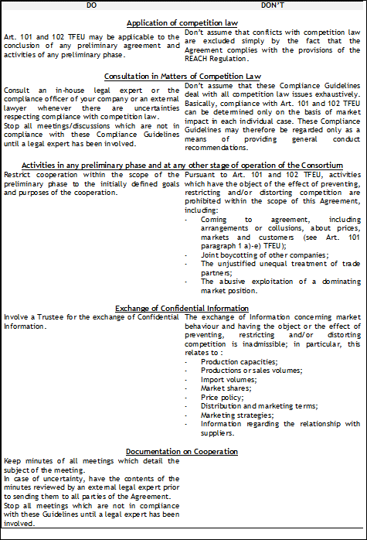
Competition Law and Confidentiality
  Attendees should refrain from any discussion on pricing, market shares and volumes and other information that could be considered as market sensitive and covered by antitrust legislation

Slide 4

Tour de table

Slide 5
Approval of the agenda
1. Welcome and Introduction (10:00-10:15)
  1.1 Confidentiality and Competition Law
  1.2. Tour de table
  1.3 Approval of the agenda
  1.4 Status of actions from last meeting
2. General facts on SVHC Roadmap Implementation (10:15-10:30)
  2.1 Implementation report 2015
  3.2 Planned activities 2016
3. Review of WG Mandate (10:30-10:45)
4. Identification of Substances of Interest to PMC (10:45-11:00)
  4.1 Outcome of screening tables
  4.2 Advocacy
5. REACH Authorisation PMC (11:00-11:30)
  5.1 ECHA’s 7th Draft Recommendation list
    5.1.1 PMC input to the public consultation
    5.1.2 Update on status
  5.2 Draft Commission proposal for next Authorisation list update (5th and 6th lists)
    5.2.1 Possible inclusion of CTP-HT and 4-Nonylphenol
    5.2.2 Status of borates, RCFs
  5.3 Preparation of ECHA’s 8th Recommendation list
6. Update on relevant Eurometaux work (11:30-11:40)
  6.1 RMOA Guidance
  6.2 REACH Review
7. Workplan and budget (11:40-11:50)
8. AOB, next meeting, closing remarks (11:50-12:00)
~
+ Special Meeting on PbO use in PM smelting (12:00-12.30)

Slide 6
Status of action points from last meeting (13/10/15)
Actions | By when? | By who? | Status
Amend mandate of the Authorisation WG | 13 October 2015 | FC | DONE
Candidate List: Companies are invited to check the List and advice secretariat if substances of interest are included | By November 2015 | Companies | DONE
Coal Tar Pitch (CTP): to check relevancy of CTP for PM industry and provide recommendation regarding the level of involvement of PMC in CTP discussions. | By November 2015 | Companies | DONE
CTP: Monitor potential spill over to other pitches used by PM and which have a similar hazard profile. | Continuous | Secretariat | ONGOING
Borates: to check the uses of Borates in their processes and the availability of alternative | By end of December 2015 | Companies | DONE
Borates: Monitor discussion at EC level on bio-essentiality and process chemicals | Continuous | Secretariat | ONGOING
Pb compounds: to check the uses of Pb compounds in their processes and the availability of alternative (to be sent to Secretariat by end of December 2015) | By end of December 2015 | Companies | DONE
Pb compounds: Monitor discussion at EC level on article 58 (2) exemption (existing OEL in place) and process chemicals (Secretariat) | Continuous | Secretariat | ONGOING
Circulate invitation of the Eurometaux Workshop on RMOA and Authorisation /Recycling to the Authorisation/SVHC WG. | October 2015 | Secretariat | DONE
Hydrazine: Check dissemination website for another uses to create alliances with different sectors and not only nuclear. | October 2015 | Secretariat | DONE

Slide 7
General facts on SVHC Roadmap Implementation

Slide 8
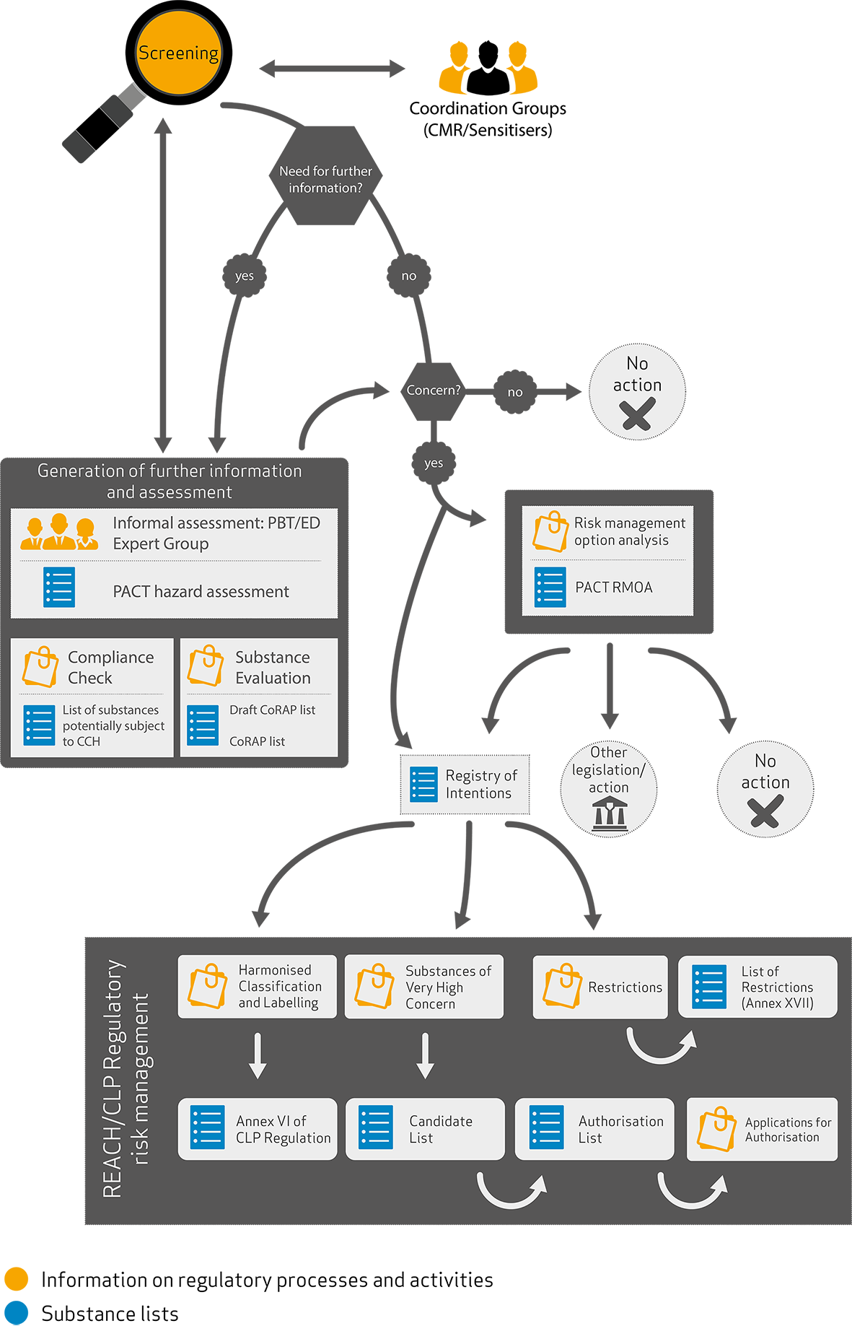
SVHC Roadmap
  General objective: All relevant, currently-known SVHCs included in the Candidate List by 2020
  SVHC Roadmap Processes
    Screening
    RMOA
    SVHC
    Restriction
    Authorisation
    CLP
  Related processes (data generation/ assessment)
    Dossier Compliance check, CoRAP, Hazard assessment
Overview of all activities under the SVHC Roadmap

Slide 9
Implementation Report 2015
  Focus has moved from already harmonised CMRs to substances with other properties such as PBT, ED, sensitizers
  Screening (IT/Manual): 76 % led to follow-up actions
    Mainly selected by ECHA, 10% added by MS as a result of their own prioritization
    Soft letters campaign (prior to manual screening) – often requests use and exposure information
  Compliance checks: 82% led to further information request
  RMOA: 65% have already led to further regulatory action (SVHC, Restriction), other actions still in preparation (CLH)
  CoRAP: 106 CMRs and 40 sensitizers currently under evaluation

Slide 10
Outline of activities planned for 2016
  PACT, which currently covers RMOA and HH, will be extended to CoRAP and CCH
  Ongoing refining of criteria for screening based on IUCLID 6
    Non-hazard criteria to be used on top of hazard criteria
      Tonnages
      Relevant uses (widespread, wide dispersive)
      Release to the environment
      Exposure to humans

Slide 11
Review of the WG mandate

Slide 12

Purpose and Scope
  Main Purposes
    Identify substances of relevance to PMC under the EU SVHC Roadmap
    Identify policy issues of relevance to PMC in the context of the Roadmap implementation (e.g. RMOA, recycling, REACH review etc.)
    Conduct advocacy in order to prevent or mitigate the potential impacts that the implementation of the Roadmap may have on the Precious Metals Industry
  Scope
    REACH: Candidate list, Authorisation, Restriction, Substance Evaluation (CoRAP), RMOA, Hazard assessment
    CLP
  NB: when a Precious Metal or a Precious Metal Compound is identified, activities shall be handled by the Sub-Assembly of that Precious Metal or Precious Metal Compound, not by the SVHC Roadmap Sub-Assembly

Slide 13
Expected output
  Information in a timely manner about new substance inclusions and public consultations
  Regular information about developments related to substances already identified as relevant
  Advocacy actions shall primarily consist in responding to public consultations. Further advocacy actions may be pursued within the limits of the agreed resources.
  WG meetings twice a year. Conf calls, additional meetings when needed

Slide 14
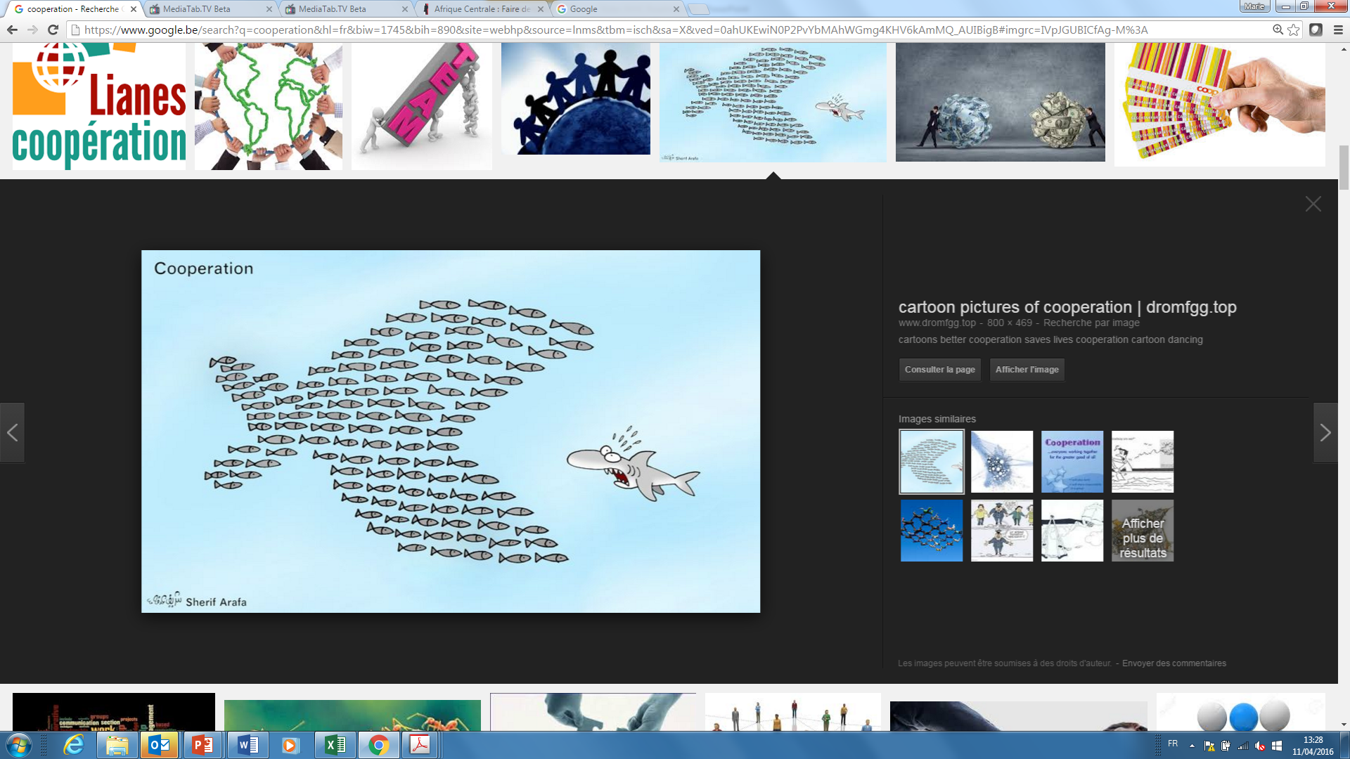
Rules for PMC Action
  Criteria for “PMC relevant” substances
    The substance is a Precious Metal or Precious Metal Compound
    The substance is (intentionally) used in Precious Metals production/recycling (e.g. as reagent or additive)
    The substance occurs as by-product, or impurity or waste generated in Precious Metals production/recycling
    The substance is related to an ancillary use (e.g. RCF’s, coal tar pitch)
Advocacy activities may be undertaken if supported by at least three Members
SUCCESS requires good cooperation from ALL ☺

Slide 15
Review of WG Mandate
Approval of the Mandate?

Slide 16
Identification of Substances of Interest to PMC

Slide 17

Outcome of screening
  75 substances identified as relevant by at least 1 member
  Low participation rate: feedback from 6 members
  Representativeness of the results?
Process at stakeexv | Substances (non exhaustive)
Authorisation | Chromium trioxide (Refinables)
Recommended for Authorisation | Borates, CTP, RCFs, Lead dinitrate
SVHC | Hydrazine, Nitrobenzene, Lead monoxide, Lead oxide sulfate, Lead diacetate,
Restriction | N,N-Dimethylformamide
RMOA | Formaldehyde (2)
CLH | Lead metal, nitric acid (2)
CoRAP | zinc oxide, titanium dioxide, cerium dioxide
Hazard assessment

Slide 18
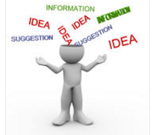
Next actions
  Keep monitoring and communicating developments for relevant substances
  “Old” substances not identified as relevant will no longer be considered
  Update on new substance inclusions, new public consultations
Suggestions on how to improve communication and participation?

Slide 19
Advocacy
  Advocacy to be initiated if relevance for at least 3 members: example of lead monoxide
  Advocacy potential as PMC as DU, i.e. for non PMC substances) Large
CoRAP
SVHC
Authorisation
CCh
RMOA
CLP
Recommendation for Authorisation
Low potential for DU advocacy
Restriction
High potential for DU advocacy
Hazard assessment
Hazard properties
Producers in first line
Hazard-based but DU RMM advocacy recommended
Use/legal entity specific
DU input recommended, but prioritisation based on ALL uses
Use specific
Primarily Info on hazard properties, Fate, Exposure

Slide 20

REACH Authorisation

Slide 21

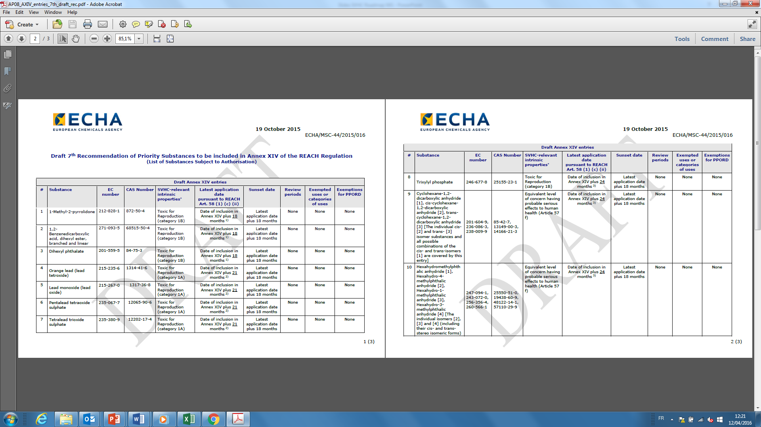
ECHA’s 7th Draft Recommendation list
  Issued in November 2015 - Public consultation until 18 February
  11 substances including 4 lead compounds
  Already in 6th list so only new Comments needed to be submitted to ECHA and Commission

Slide 22
ECHA’s 7th Draft Recommendation list
  PMC submitted comments on lead monoxide Use as laboratory chemical in PM content analysis (fire assaying)
    Argued for absence of alternatives and eligibility for Art. 58(2) exemption based on existing binding OEL for lead and lead compounds which ensures proper risk management
  Other uses identified of lead monoxide:
    Glass frits production (already covered under 6th work)
    PM smelting (not reported under 6th list work)
    Impurity in refinables / slags (in principle not relevant for Authorisation)
  Use of Lead monoxide in Precious Metals Smelting
    Currently not declared in ILA dossier but ILA supports inclusion of use
    Need to agree on use description -> Dedicated meeting right after this meeting!

Slide 23
ECHA’s 7th Draft Recommendation list
  Status update
    First reporting on outcome of public consultation expected at the MSC end of April 2016
    7th Recommendation list to be adopted by ECHA and sent to the Commission in June 2016
    Possible inclusion in REACH Authorisation end 2016/early 2017

Slide 24
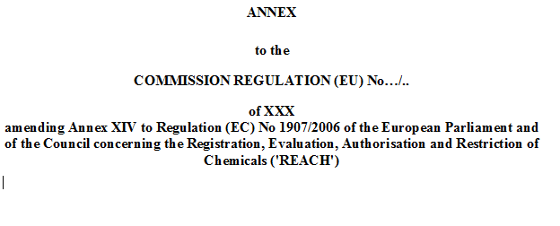
EC Draft for next Authorisation list update
  Draft EC proposal contains 13 substances
  Vote expected at the next REACH Committee (May/June)
  Next update of Annex XIV expected 2nd half 2016
  2 substances identified as relevant by 1 member:
    CTP-HT
    4- Nonylphenol

Slide 25

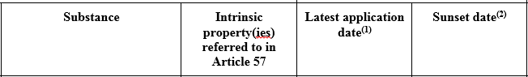
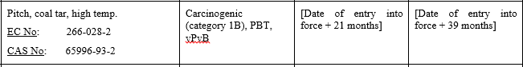
EC Draft for next Authorisation list update
  CTP-HT
      LAD of 21 months and SSD + 18 months
      SEA route due to PBT
      Intermediates case clarified for use in Anodes and Cathodes in the metals sector. Some uses “collar and ramming paste” remain authorisable
    Most, if not all Member States seem to support the inclusion
Reported by 1 member, no further PMC involvement

Slide 26

EC Draft for next Authorisation list update
  4-Nonylphenol
      LAD of 24 months and SSD of + 18 months
Reported by 1 member, no further PMC involvement

Slide 27
Status update on Borates
  Not suggested for Annex XIV inclusion this year
  Basis:
    Need clarification on bioessential uses and use in nuclear sector
    workload
  Score remains high, so likely to be further considered for inclusion in 2017
  PMC joined Borates Users Platform (EBA)
    National platforms in FR, DE
Reported by more than 3 members, further PMC involvement

Slide 28
Status update on RCFs
  Aluminosilicate Refractory Ceramic Fibres (Al-RCF) and Zirconia Aluminosilicate Refractory Ceramic Fibres (Zr-RCF)
  Inclusion postponed “for the time being”, assessment of other regulatory options
    Actual fibres manufactured in a very limited number of industrial sites and in general directly processed into articles
    Articles subsequently used in a broad range of industrial equipment for high insulation purposes – but use of articles outside Authorisation
  In parallel: activities leading to implementation of a BOELV under OSH Regulation (Annex 3 of CMD)
    Commission consultation expected after Easter
    A first set of limit values could be implemented by the end of the year
Reported by 1 member, no further PMC involvement

Slide 29

Preparation of ECHA’s 8th Rec. list
  Autumn 2016: rescoring exercise for all SVHCs not included in 7th recommendation
  Discussion on draft prioritisation results in preparation of the 8th recommendation foreseen for MSC mtg in December 2016
  Discussion on draft 8th recommendation at MSC mtg in February 2017
  Public consultation could start around March 2017

Slide 30
Current scoring (from 45 to 1)
Substance identified as relevant by at least 1 member | PM relevant use | Scoring
1-Methyl-2-pyrrolidone (NMP) | Analytics | 28
Nitrobenzene | PM production | 20
Cadmium | May be present in feeds, refinables, by-product | 16
Hydrazine | PM production | 15
Lead dinitrate | Used in gold cyanidation and in catalysts; additive for galvanic baths | 13
Phenolphtalein | Analytics | 9
Trilead bis(carbonate)dihydroxide | PM smelting | 9
Cadmium chloride | PM refining: not used, but can be present in feeds and refinables; R&D | 5
Lead oxide sulfate | Additive for galvanic baths, analytics | 5

Slide 31

Eurometaux workshop
  Eurometaux workshop on intermediate or article status for 8th list substances to take place early 2017
Already suggestions of potential intermediate uses to be discussed with ECHA?

Slide 32

Update on Eurometaux work

Slide 33
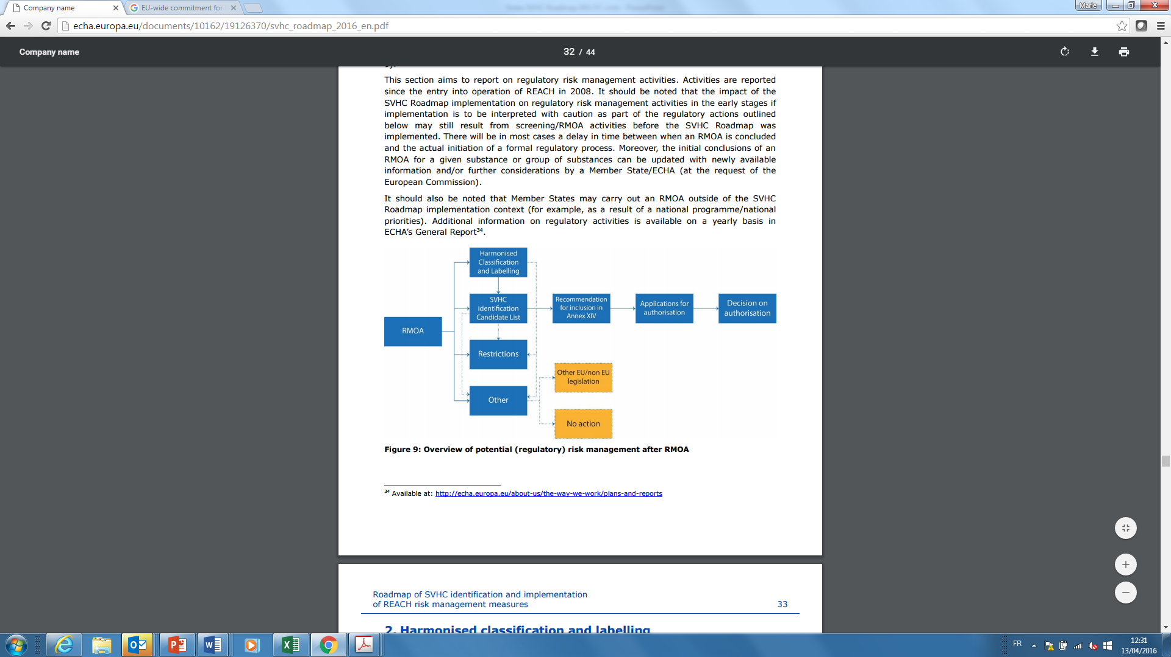
RMOA Guidance
  Non-regulatory tool introduced by Member States „helping to define the need for and best Risk Management choice”
  Originally mainly applied for authorisation (Authorisation vs. Restriction) but broadened its scope to other RMMs including non-REACH related tools

Slide 34

RMOA Guidance
  An RMOa intention by a Member State or ECHA is usually pre-announced on the PACT list
  Improvement of REACH given it helps to decide for RMM in a more structural and transparent way
  However, a shortcoming: no common methodology
  PMC conducted an RMOA for Chloroplatinates in 2015!

Slide 35
RMOA Guidance
  Eurometaux RMOA guidance finalised early 2016 and to be presented to ECHA mid 2016
  Objectives:
    Common methodology for Industry but possibly also ECHA and Member states based on potential efficiency and efficacy of the RMM
    Help Industry to Anticipate on official RMOAs
      Identify additional data needs beyond information in the registration dossiers that could help define the best RMOA option
      Help align manufacturers and their supply chains on relevant RMOA needs, information required and implementation
    Help Industry to Contribute credibly and in a transparent way to the RMO analysis and decision process at EU level

Slide 36
Main components of the Guidance
The proposed technique builds on a series of logical elements including:
  Substance information on hazards and regulatory status in the EU
  Uses, volumes and potential exposure throughout the Life Cycle of the substance
  Alternatives per (identified) use
  Initial Socio-economic information by use
  And a synthesis on the Risk Management Options that could be considered

Slide 37
Experience from industry
  Experience by industry shows that conducting an RMOa:
  Takes 4 to 6 months
  Requires 2 to 3 meetings with manufactures and users
  Is best followed/complemented by an external independent reviewer to keep the mind-set as open as possible
  Sometimes requires a mechanism to handle confidential information (e.g. the existence or development of suitable and feasible alternatives)
  Results in a conclusion scheme that identifies further information needs as well as an indication as to which information is most relevant.
  Somewhat depending on the additional needs, such additional data development usually takes at least 2 to 3 months

Slide 38
2017 REACH Review
  Commission report on REACH Review by 1 June 2017
  Entire REACH text subject to review
  Preparation work has already started (EC launched several studies)
  Eurometaux strategy:
    Set up REACH Review TaskForce (March) - PMC is a member
    Final EM position and advocacy plan (September)
      Develop and identify top-three critical items of relevance for metals / EM
        Key item: RMM approach !!
    Eurometaux Event (October, tbc)

Slide 39
Workplan and Budget

Slide 40
Workplan 2016-2017
Key tasks 2016
Monitoring | Possible PMC advocacy
Roadmap implementation | ECHA’s 7th list (PbO) - Commission, MS
REACH Review | ECHA’s 8th list (Borates) - Intermediate workshop - Borates DU platform
Key tasks 2017
Monitoring | Possible PMC advocacy
Roadmap implementation | PbO – Annex XIV?
REACH Review | ECHA’s 8th list
 | RMOA (e.g. Formaldehyde)

Slide 41
Budget
2016 Budget
  20 000 EUR budget not spent so far, will be carried over to 2017
2017 Budget
  No further expenses planned for the time being but subject to change depending on Annex XIV developments
HR 2017: 0,4 FTE (2 x more than 2016!)

Slide 42
AOB, Next meeting,
Closing remarks

Slide 43
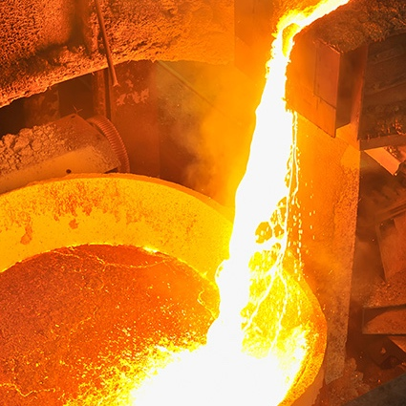

THANK YOU
www.epmf.be | info@epmf.be
Avenue de Broqueville 12, B-1150 Brussels
+32 (0)2 775 63 86
© European Precious Metals Federation 2015

